Slide 1
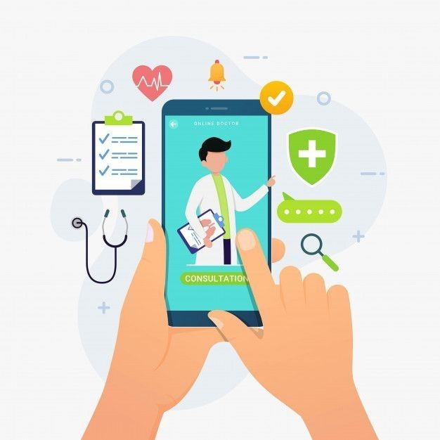

Dermascan AI:
Skin Condition Prediction System

Slide 2
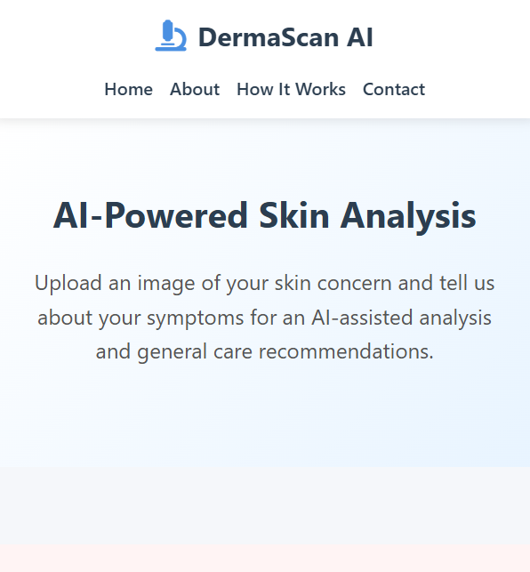
Introducing Dermascan AI
Skin health plays a vital role in overall well-being, yet many people tend to ignore minor skin concerns. Often, individuals hesitate to consult a doctor for small issues, while searching online for solutions can lead to confusion due to the overwhelming and sometimes misleading information.
To address this gap, our project introduce skin condition prediction tool that provides quick guidance and awareness. It is designed purely for educational purposes, helping users gain basic insights about possible skin concerns while encouraging them to seek professional advice when needed.
.
.

Slide 3




Why Dermascan AI?
Rapid Insights
Promotes Early Care
Empowering users with quick understanding of potential skin conditions.
Encouraging timely consultations with dermatologists for professional diagnosis.
Awareness & Education
AI in Healthcare
Increasing general knowledge and awareness regarding various skin health issues.
Showcasing the transformative application of AI in accessible healthcare solutions.

Slide 4
Key Features
User Friendly Interface
Provides General Solutions
Simple, user-friendly design for image uploads and data input.
Offers simple, common remedies and self-care tips for detected problems.
Awareness Focused
Educational Guidance
Encourages early awareness of skin concerns before they get worse.
Designed to raise awareness, not replace medical diagnosis

Slide 5
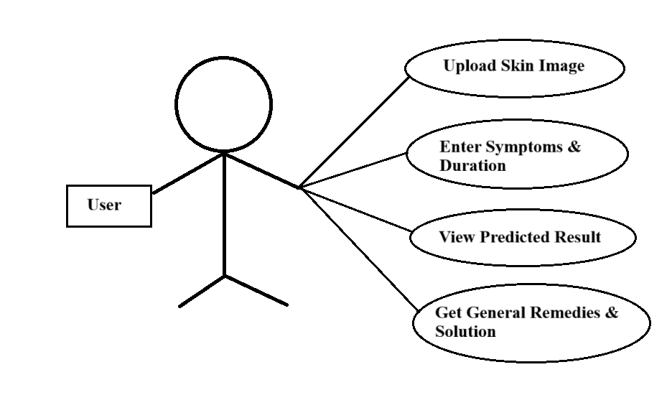
Use Case Diagram

Slide 6
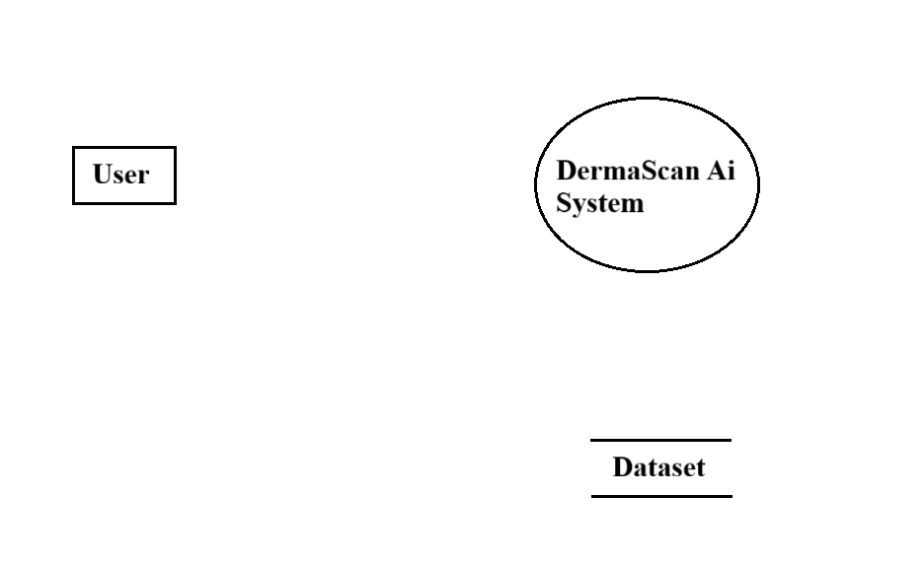
Data Flow Diagram
Level-0
Input
Get Result
Response
Query

Slide 7



Our Technology Stack
Frontend
Backend
Tools Used
Built with standard web technologies: HTML, CSS, and JavaScript for a robust and dynamic user interface.
For the backend, Python is used along with ML libraries with Flask to power the skin analysis model. Additionally, a dataset of skin conditions is utilized support the AI model, efficient predictions.
Vs Code: For coding and project development
MS-Word: For preparing documentation
MS- PowerPoint: For preparing presentation

Slide 8
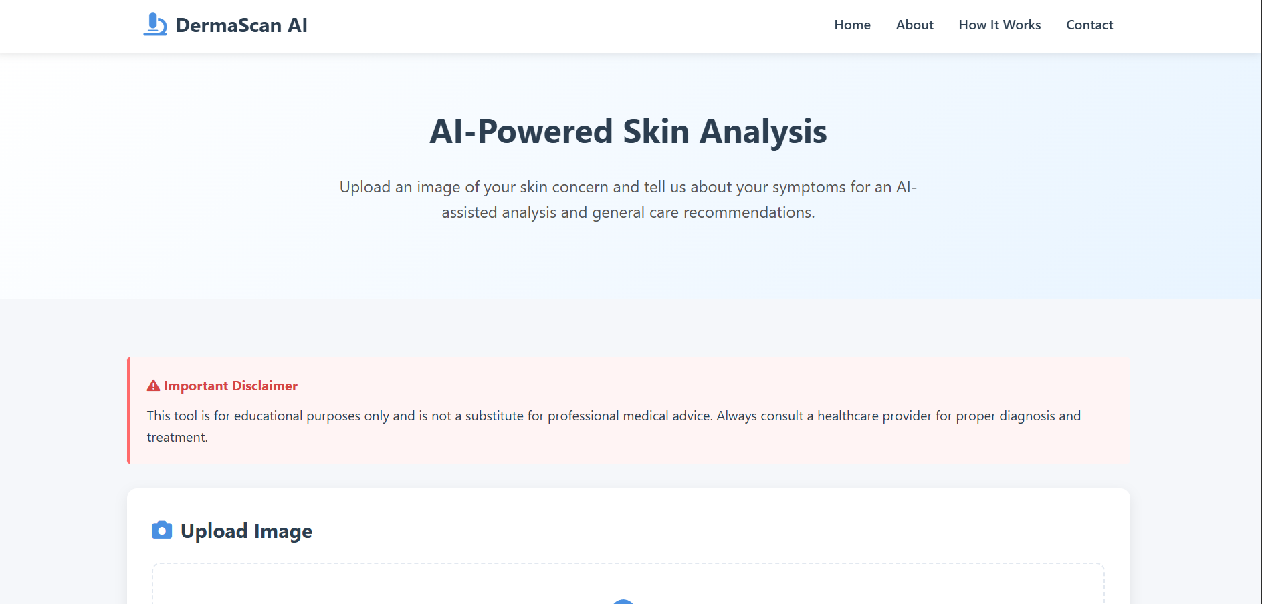
User Interface

Slide 9
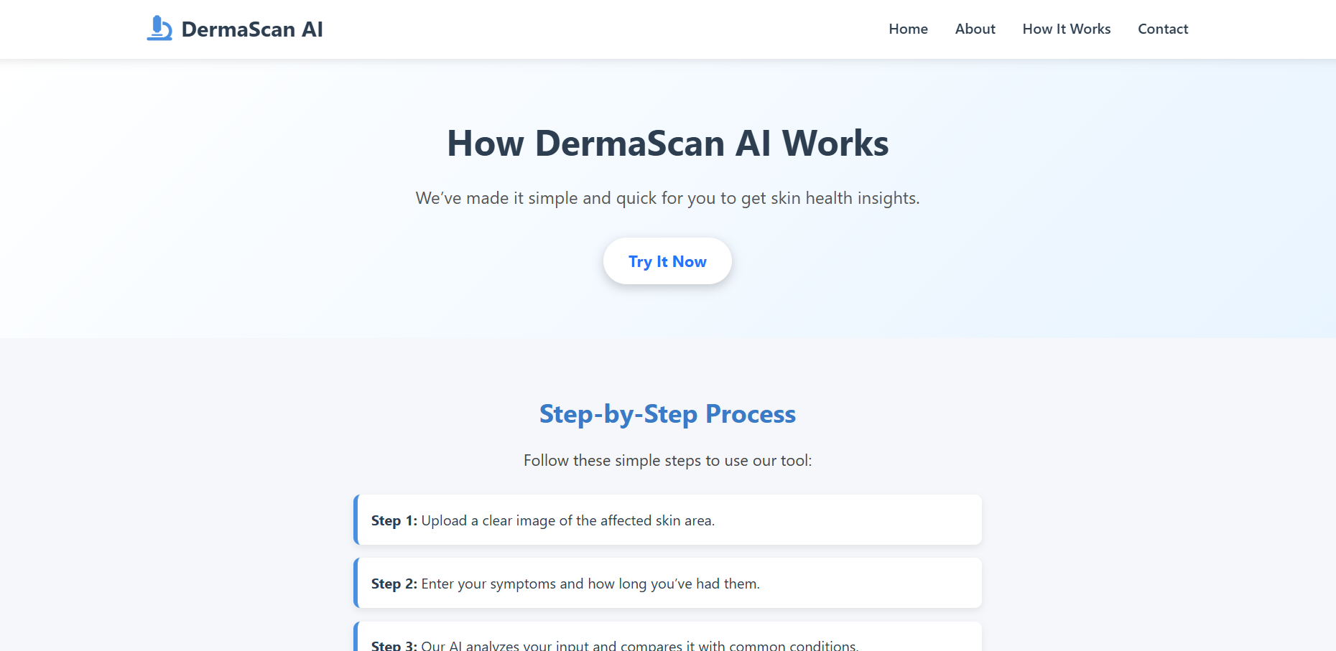

Slide 10
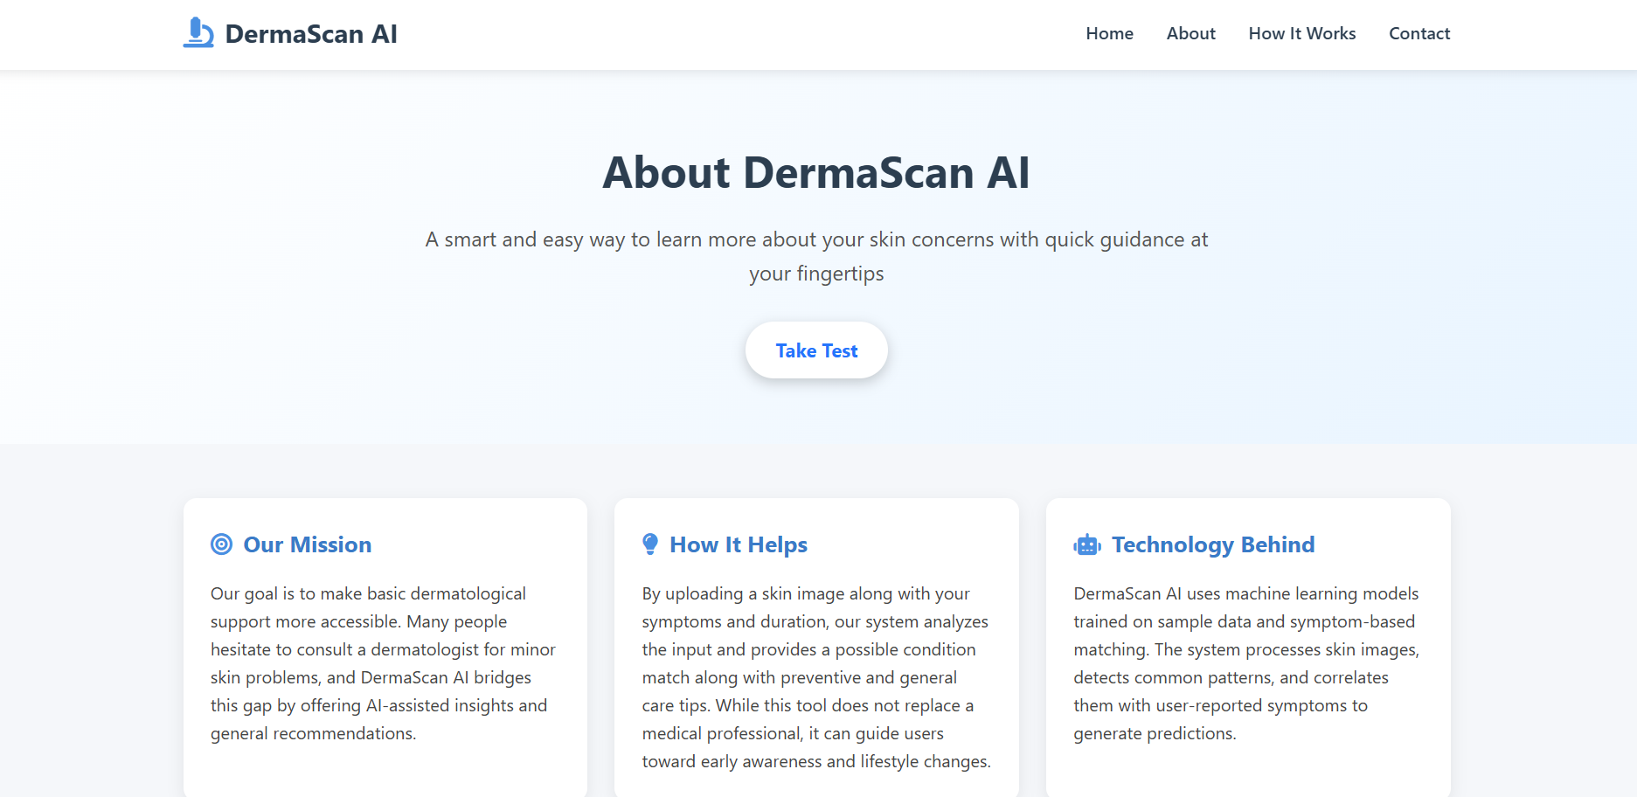

Slide 11
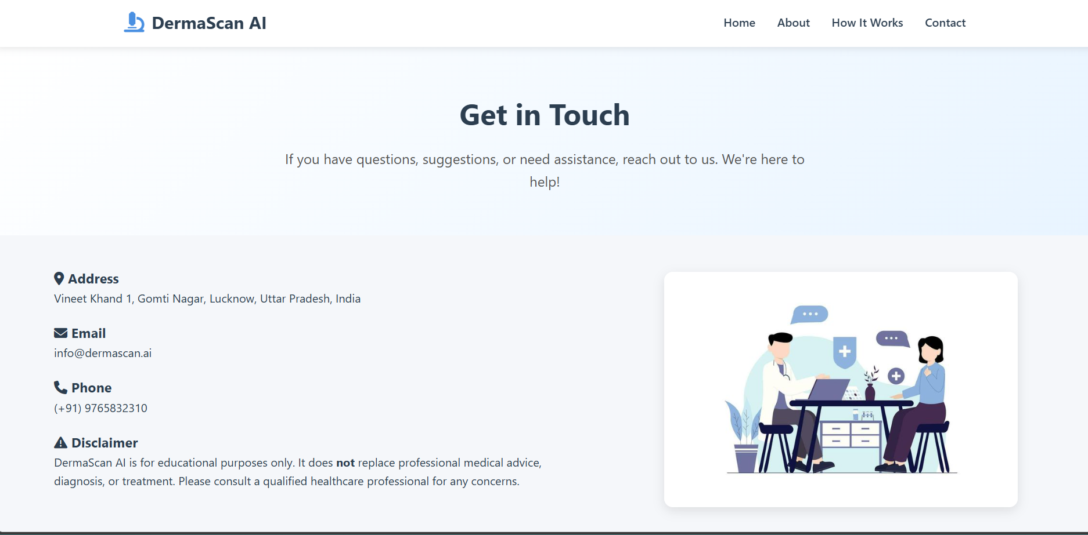

Slide 12

Limitations
Not a Medical Diagnosis
Dermascan AI is purely an educational and awareness tool. It is not a substitute for professional medical advice, diagnosis, or treatment from a qualified healthcare provider.
Accuracy Dependence: The reliability of predictions is directly linked to the quality of uploaded images and the completeness of input data.
Educational Focus: Currently, the application is intended for informational purposes only, supporting users in understanding potential conditions.

Slide 13




Future Scope
Enhanced AI Integration
Integrating with a fully trained, real-world AI model for significantly higher prediction accuracy.
Multi-Language Support
Expanding accessibility by offering the application in multiple languages.
Real-time Consultations
Enabling direct, real-time chat functionality with certified dermatologists within the platform.
Mobile Application
Developing dedicated mobile apps for iOS and Android to ensure wider reach and convenience.

Slide 14

Thank You
Richa Singh
BCA – 3rd Year

